Slide 1
U.S. Department of Housing and Urban Development

Slide 2
ESG and CoC Match Carrie L. Fortune, Esq. Senior CPD Representative Program Environmental Specialist

Slide 3
Agenda
Federal Regulations
Cash Match
In-Kind Match
Summary
Questions

Slide 4
Federal Regulations
Governed by:
2 CFR Part 200, specifically 2 CFR § 200.201 (all Federal programs)
24 CFR § 576.201 (Emergency Solutions Grant)
24 CFR § 578.73 (Continuum of Care Program)

Slide 5
Program Specific Match
ESG requires match in an amount equal to the grant (24 CFR 576.201(a))
The CoC Program requires no less than 25% match of all grant funds, except for leasing (24 CFR 578.73(a))

Slide 6
Match in General
In order to be considered match, including cash and in-kind contributions, such contributions must meet all the following criteria:
are verifiable from the non-Federal entity's records;
are not included as contributions for any other Federal award;
are necessary and reasonable for accomplishment of project objectives;
are provided for in the approved budget when required by the Federal awarding agency; and
conform to other provisions of this part, as applicable.

Slide 7
Match in General
Recipients can pass some or all the match requirement onto subrecipients
Match must be for eligible activities, but does not need to be by line item (i.e. $10,000 in HMIS funding does not require $2,500 match in HMIS activities)

Slide 8
Cash Match
Cash match is cash expended by recipient or subrecipient for
allowable costs
The recipient/subrecipient may use funds from another Federal
program as match for ESG, unless doing so would violate a specific
statutory prohibition
The recipient/subrecipient may NOT use (its own or another entitlement community’s) ESG funds as match for an ESG grant
The recipient/subrecipient may NOT use CoC funds as match for a CoC grant
Cash donations, foundation grants, state and local funds, etc. may be used as match when spent on allowable costs
Cash match must be expended during the recipient’s grant period

Slide 9
Cash Match
For the CoC Program, the client’s portion of rent when paid to the recipient/ subrecipient is program income, which can be used as match
For ESG, any amount of security and utility deposit returned to the recipient/ subrecipient is program income, which can be used as match

Slide 10
Cash Match Documentation
During monitoring, documentation of the receipt of cash match and expenditure on an eligible cost(s) is required
Documentation of client rent contributions shown as a receivable with payment of full rent paid to landlord should be shown during monitoring
Tracking logs are helpful to ensure sufficient cash match during the grant

Slide 11
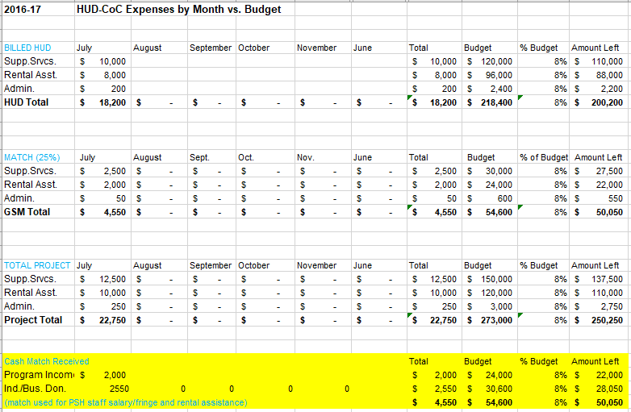
Cash Match Documentation
Example of match tracking log:

Slide 12
In-kind Match
In-kind match is the value of any real property, equipment, goods or services contributed to the ESG/CoC program, provided that if the recipient/subrecipient had to pay for them with grant funds, the costs would be allowable. Noncash contributions may also include the purchase value of any donated building.
volunteer services furnished by third-party professional and technical personnel, consultants, and other skilled and unskilled labor may be counted as match if the service is an integral and necessary part of an approved project
services provided by individuals must be valued at rates consistent with those ordinarily paid for similar work in the recipient/subrecipient's organization. If the recipient/subrecipient does not have employees performing similar work, the rates must be consistent with those ordinarily paid by other employers for similar work in the same labor market
if a third party is paying the “volunteer”, the services provided must be valued at the employee's regular rate of pay plus an amount of fringe benefits that is reasonable, necessary, allocable, and otherwise allowable, provided these services employ the same skills for which the employee is normally paid

Slide 13
In-kind Match (Continued)
donated property from third parties may include such items as equipment, office supplies, laboratory supplies, or workshop and classroom supplies. Value assessed to donated property included as match must not exceed the fair market value of the property at the time of the donation
the value of donated equipment must not exceed the fair market value of equipment of the same age and condition at the time of donation. The value of loaned equipment must not exceed its fair rental value
the value of donated land and buildings must not exceed its fair market value at the time of donation to the non-Federal entity as established by an independent appraiser and certified by a responsible official of the non-Federal entity
to determine the value of any donated material or building, or of any lease, the recipient must use a method reasonably calculated to establish the fair market value
the value of donated space must not exceed the fair rental value of comparable space as established by an independent appraisal of comparable space and facilities in a privately-owned building in the same locality
In-kind match must be received during the recipient’s grant period

Slide 14
In-kind Match – Mainstream Benefits
FAQ on mainstream benefits for CoC match can be found here: https://www.hudexchange.info/faqs/1563/are-mainstream-benefits-that-are-paid-directly-to-program-participants/
Mainstream benefits (food assistance, TANF, mental health services, etc.) provided directly to program participants are not considered match by HUD because they are based on the program participant’s eligibility rather than committed to the recipient/subrecipient for activities funded by the program
An exception is when funds are provided directly to the recipient/subrecipient for use in a CoC project, but this is cash match
Example – CMH receives Medicaid funds to provide mental health services to the program participants in their CoC program = MATCH
Example – CMH provides mental health services to another agency’s CoC program participants who meet CMH’s eligibility = NOT MATCH

Slide 15
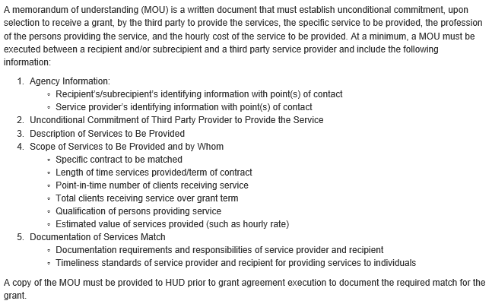
In-kind Match MOU
An FAQ on the minimum requirements of a CoC Program MOU for in-kind match can be found at https://www.hudexchange.info/faqs/1562/what-are-the-minimum-requirements-of-a-memorandum-of-understanding/

Slide 16
In-kind Match Documentation
The podcast The Importance of Documenting Match Under the CoC Program can be found at: https://www.onecpd.info/resource/3113/importance-of-documenting-match-under-the-coc-program/
A helpful FAQ on cash match for ESG can be found at: https://www.hudexchange.info/faqs/1086/what-sources-of-funds-can-be-used-as-cash-match-for-esg/

Slide 17
In-kind Match Documentation
Examples of in-kind match documentation:
Volunteer sign-in/out sheets
Standardized local rates for specific types of services
Documentation of current minimum wage
Letters of donation
Documentation of value of building, equipment and/or goods

Slide 18
Summary
Cash and in-kind contributions can be used for match if they come from an eligible source and are spent on an eligible, necessary cost
Match must be expended (cash) or received (in-kind) during the grant period in which it is being considered match
Documentation is critical – time sheets/pay stubs, volunteer sign in sheets, letters of donation, written documentation of value, etc.
Mainstream resources are rarely match so check with HUD before attempting to use it as such

Slide 19
Questions

